Slide 1
OPERATION ANALYTICS AND INVESTIGATING METRIC SPIKE

Slide 2
PROJECT DESCRIPTION :
This project involves conducting a comprehensive analysis of the end-to-end operations of a company based on two case studies. There were 2 case studies given 2 work upon. A brief description of both case studies and output required form both of them are given below :-
APPROACH :
To conduct a comprehensive analysis of a company's end-to-end operations based on case studies, we would typically follow a structured approach that involves several key steps like , define the objective , collect data , analyse data , identify areas of improvement etc .
Tech-Stack Used :
MySQL, PostgreSQL, Excel, Word, Ppt

Slide 3
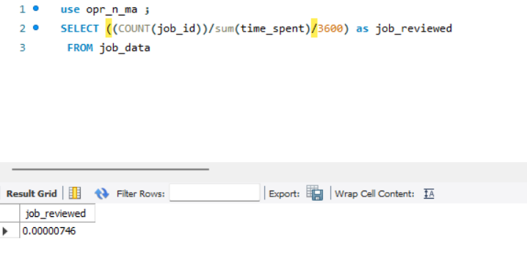
1. Amount of jobs reviewed over time.

Slide 4
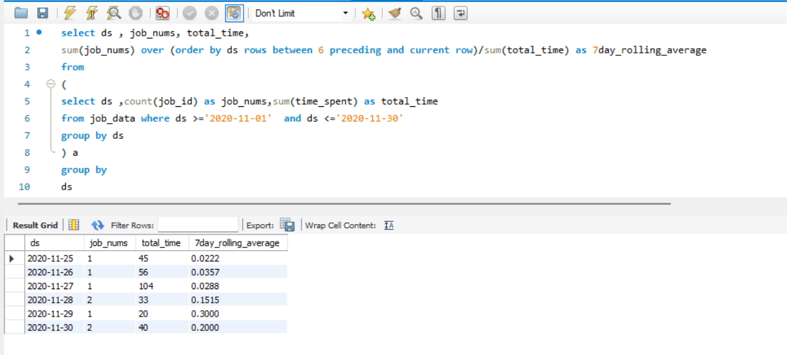
2. No. of events happening per second – to calculate 7 day rolling average.

Slide 5
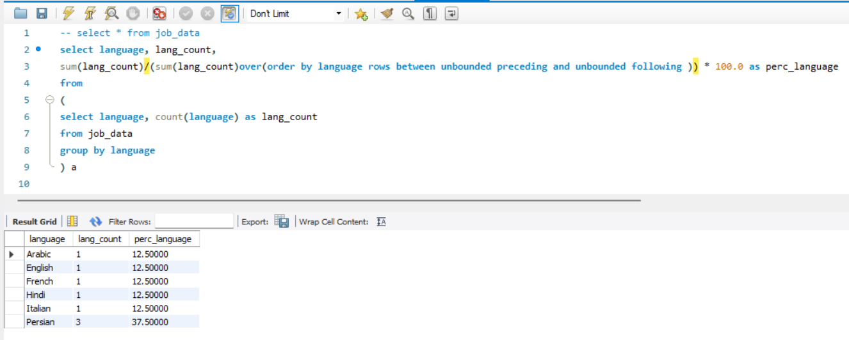
3. Share of each language for different contents.

Slide 6
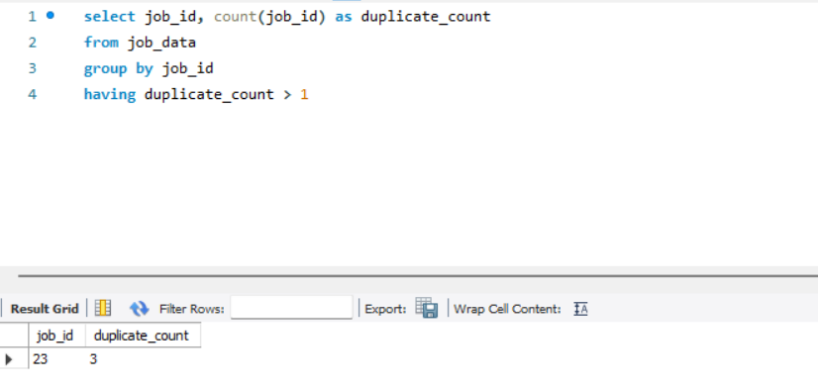
4. Rows that have same values present in them.

Slide 7
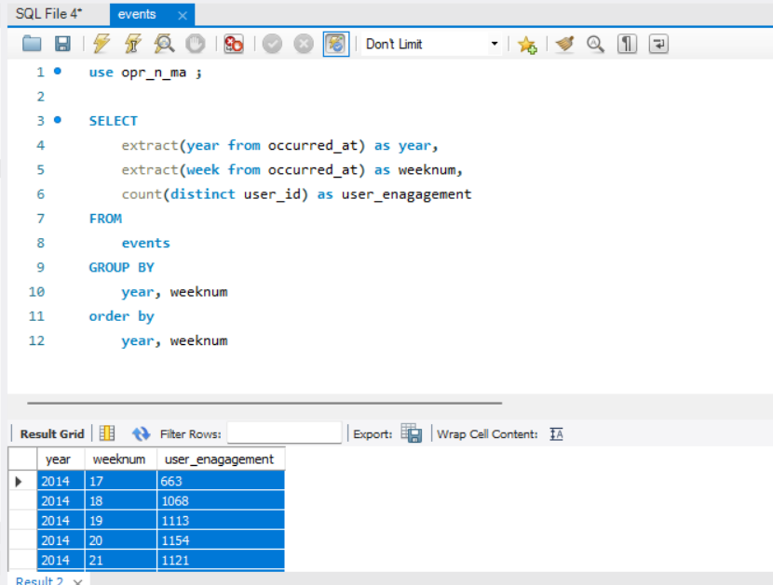
CASE STUDY 02 - INVESTIGATING METRIC SPIKE
5. To measure the activeness of a user.

Slide 8
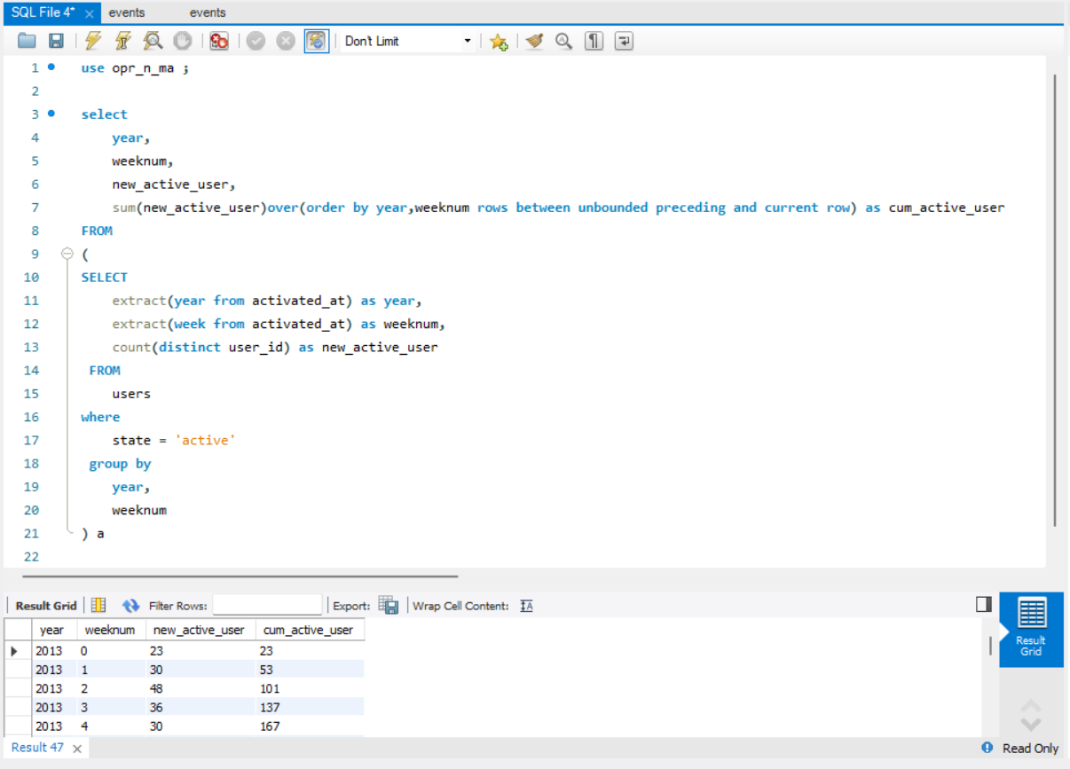
6. Amount of users growing over time for a product – number of active users per week.

Slide 9
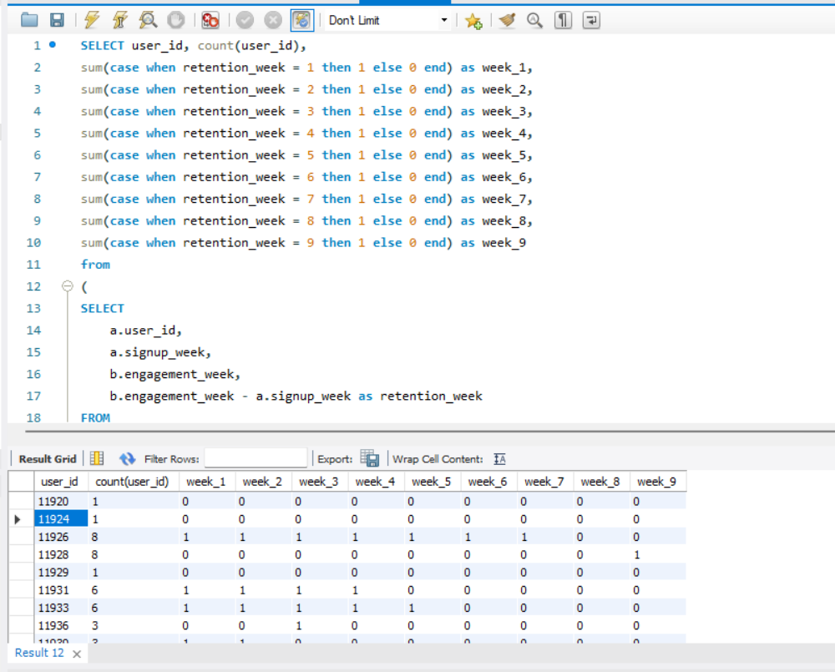
7. Users getting retained weekly after signing up for a product.

Slide 10
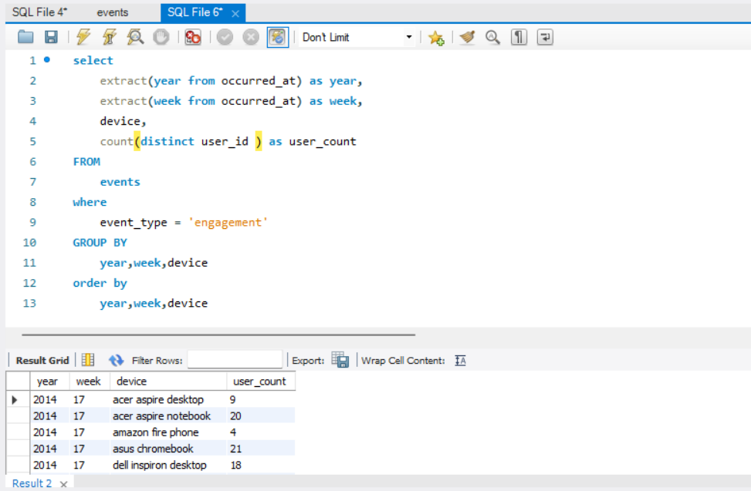
8. To measure the activeness of a user weekly - Calculate the weekly engagement per device.

Slide 11
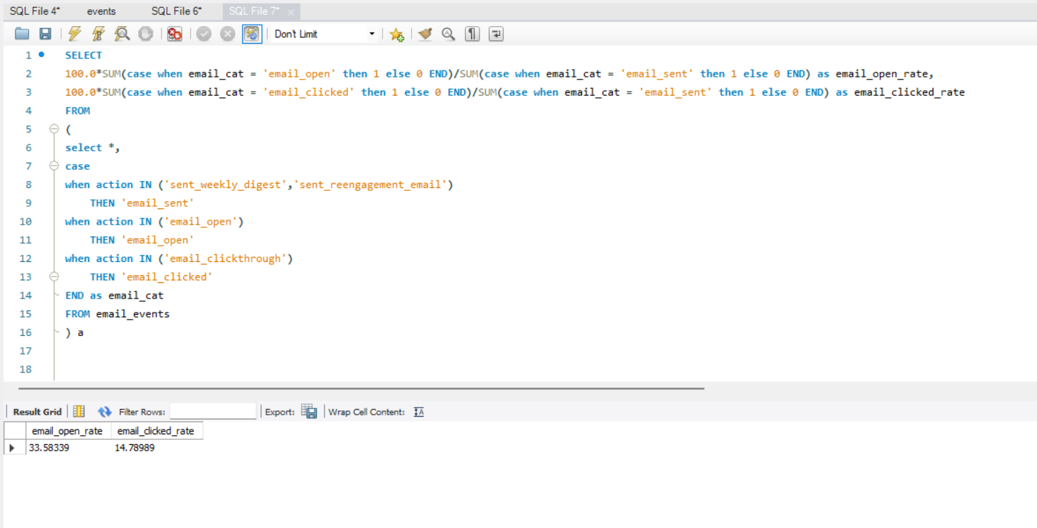
9. Users engaging with the email service.

Slide 12
RESULTS :
Results obtained are displayed above.
This project made me understand the importance collecting the right data and its usage.

